Slide 1
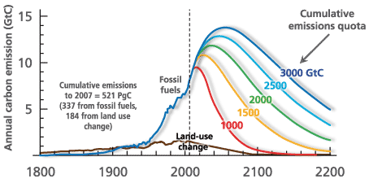
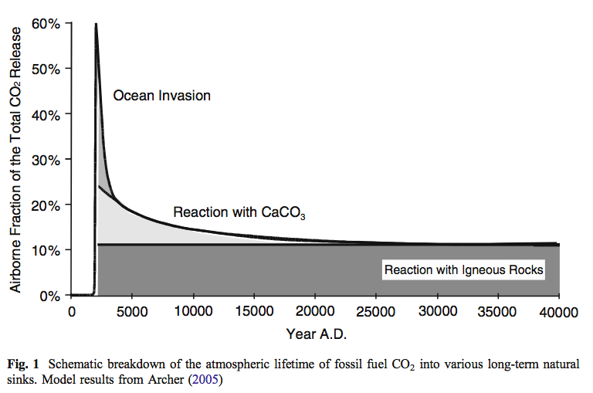
Our CO₂ legacy
Cumulative emissions (e.g., 1500 GtC total)
100%
40% of anthropogenic CO₂ emitted in any given year is absorbed, within the year, by oceans and land
By year 3000, oceans will absorb another 40%.
By year 25,000, another 10% is absorbed
20% of what we emit today will still be in the air in year 3000
10% of what we emit today will still be in the air in year 25,000
The rest has to be removed by mountain-building (reactions with igneous rocks)
Notes:
http://www.igbp.net/news/features/features/havewereachedpeakco2.5.1b8ae20512db692f2a680003465.html

Slide 2
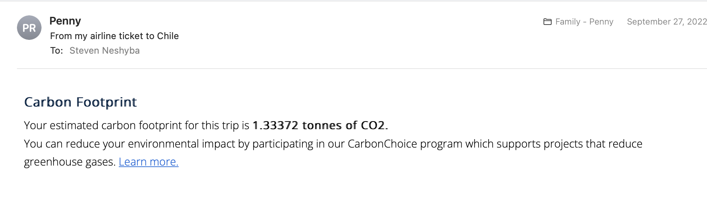
Our CO₂ legacy

Slide 3
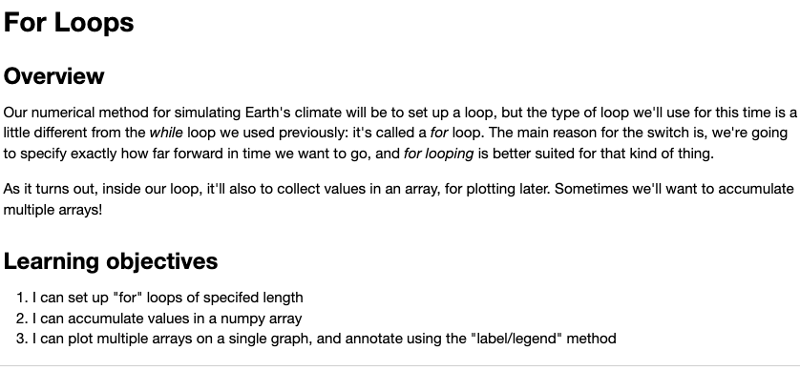
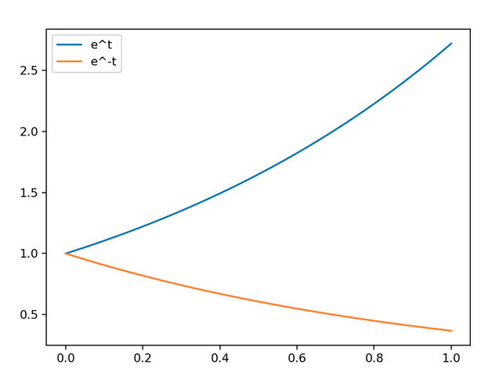
Week 6a – For Loops

Slide 4
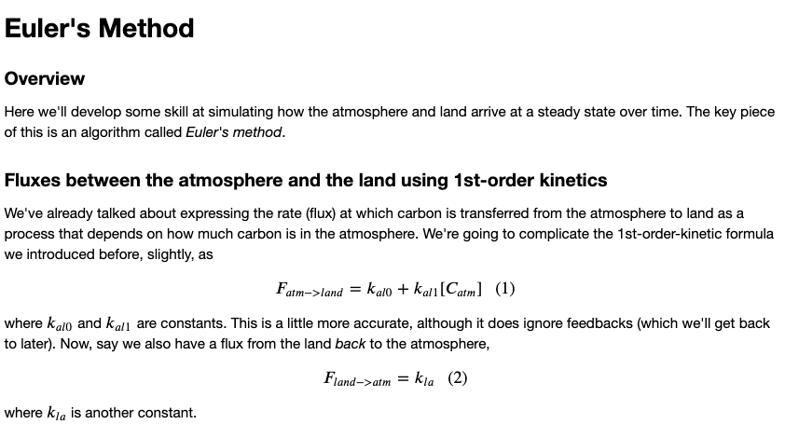
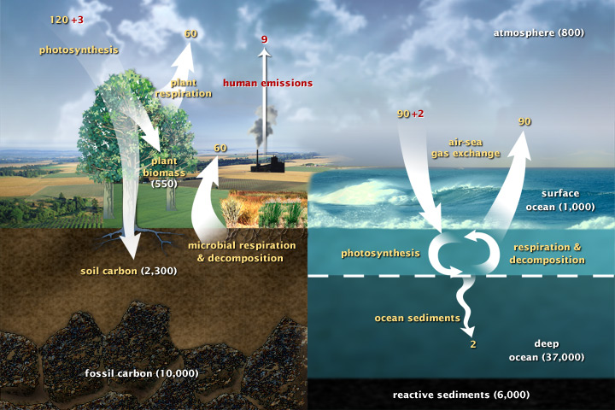
Week 6b – Euler’s Method

Slide 5
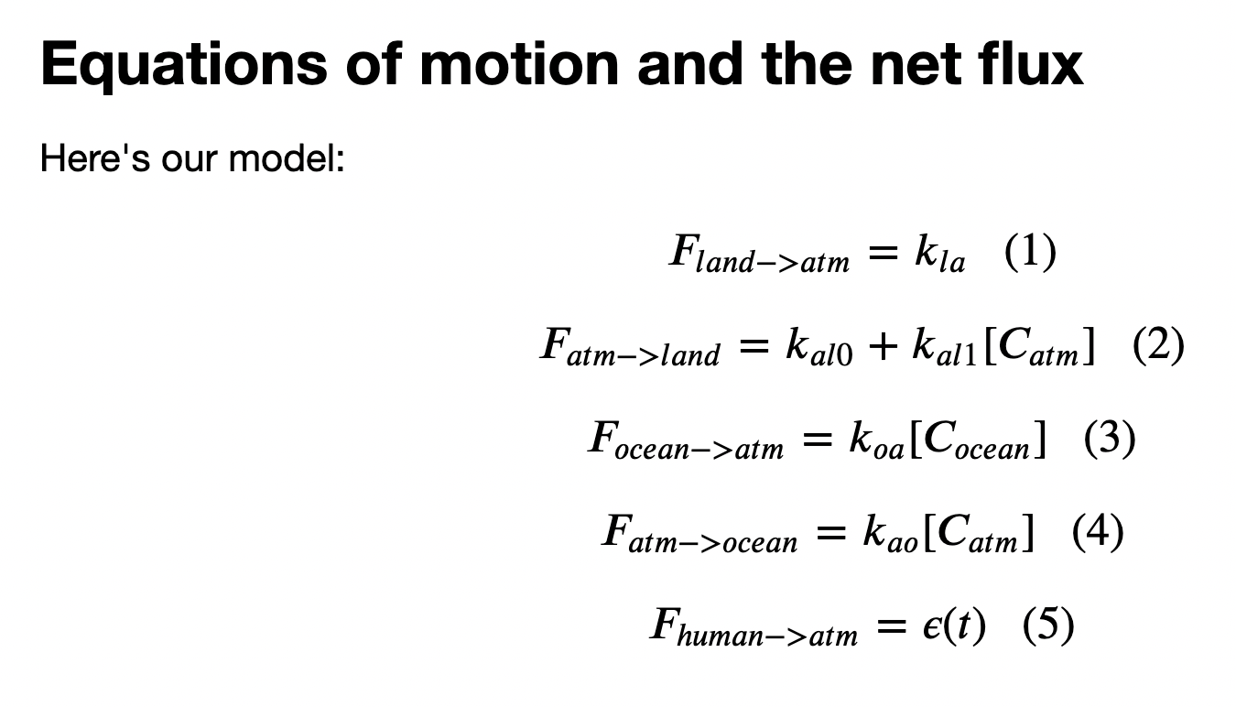
Week 6c – Cambio1.0

Slide 6
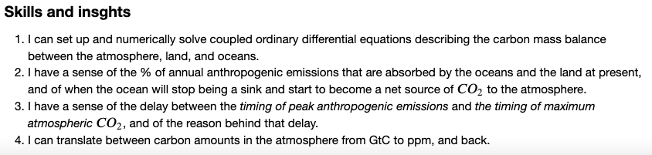
Week 6c – Cambio1.0

Slide 7
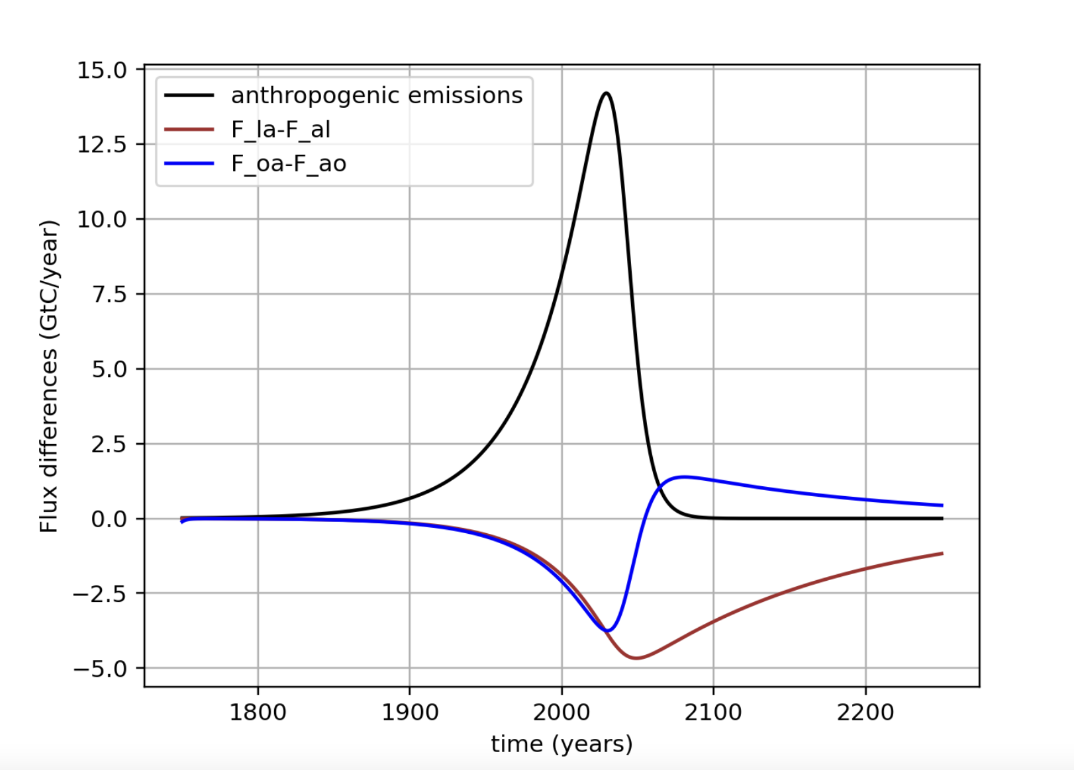
Week 6c – Cambio1.0

Slide 8
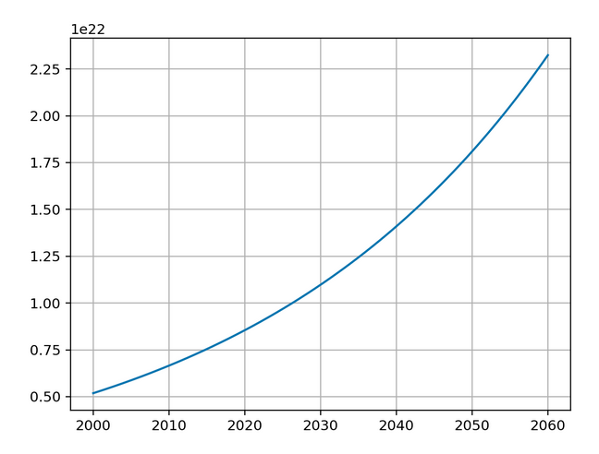
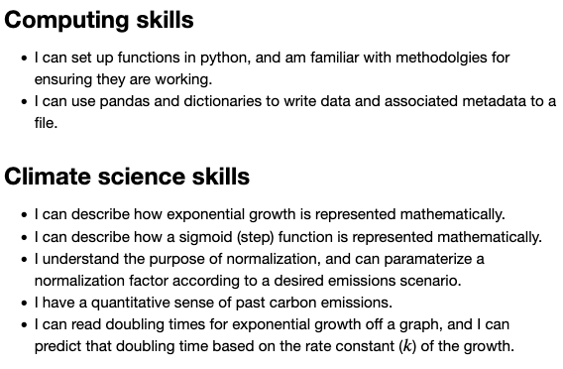
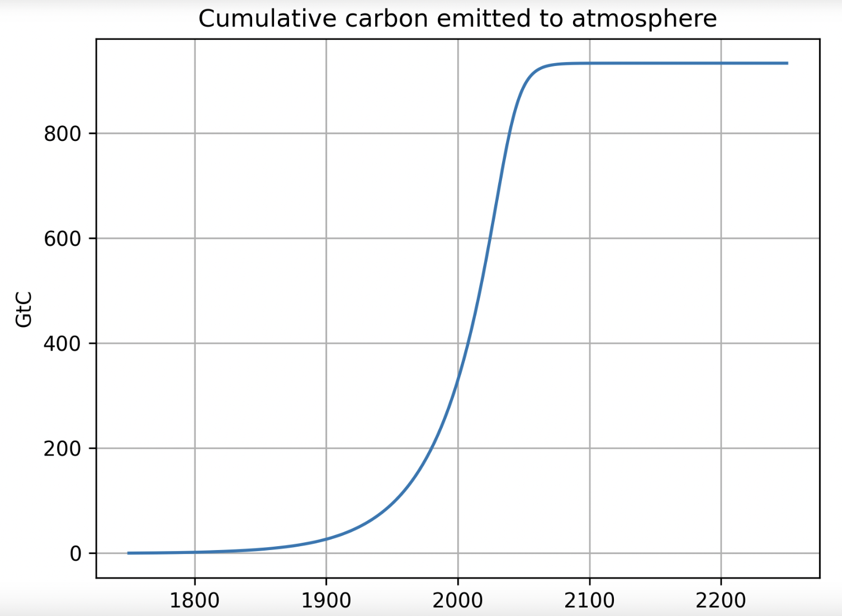
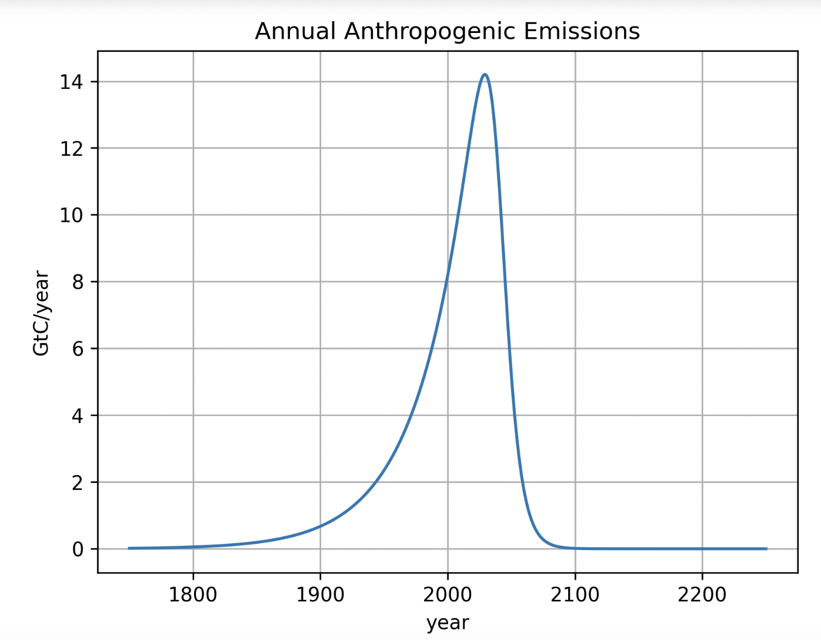
Week 5a – Scheduled flows

Slide 9
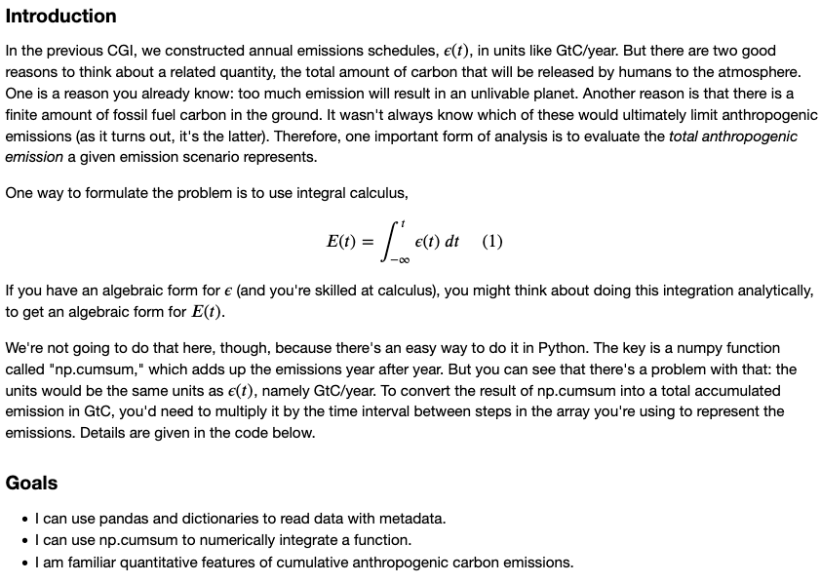
Week 5b – Cumulative Analysis

Slide 10
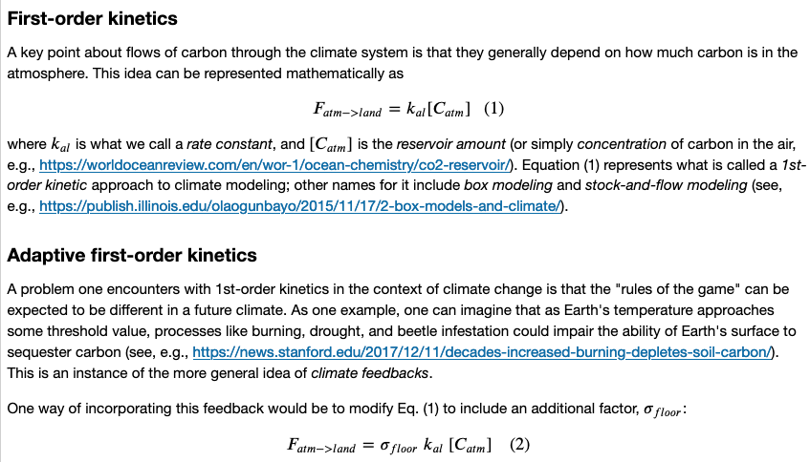
Week 5c – Adaptive flows

Slide 11
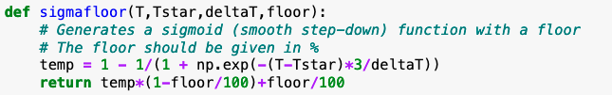
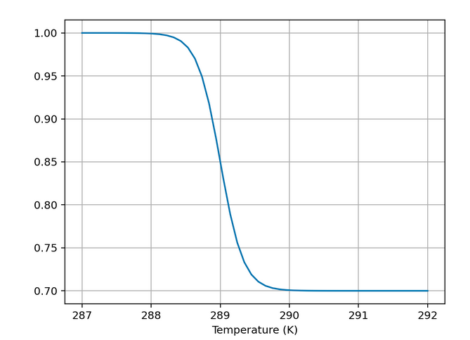
Week 5c – Adaptive flows

Slide 12
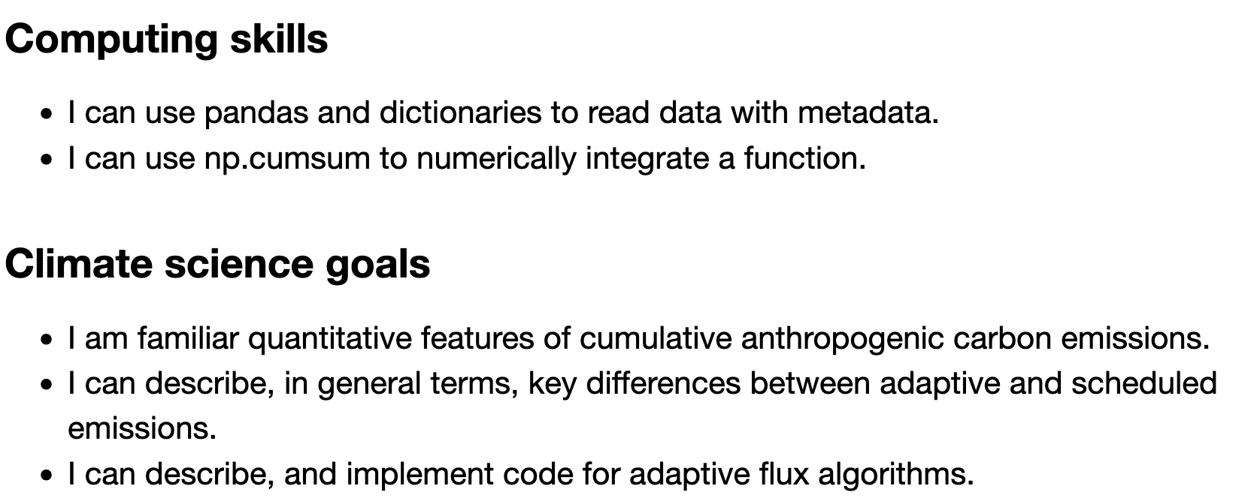
Week 5 – Adaptive flows

Slide 13
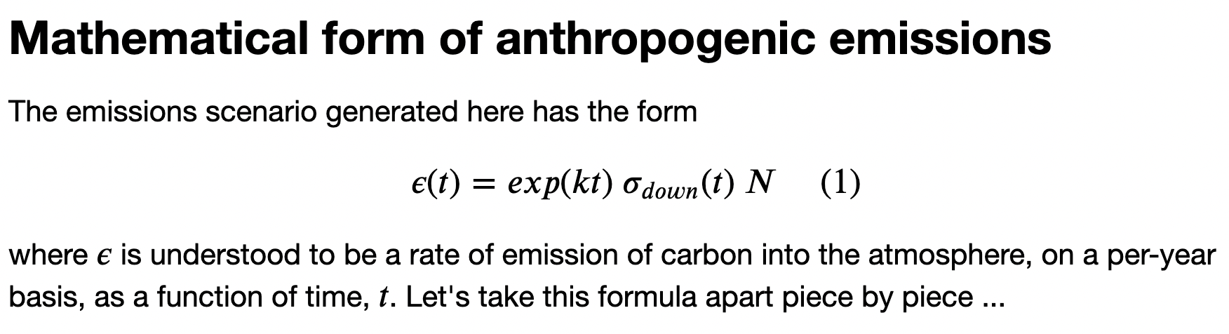
Week 5 – Adaptive flows and scheduled flows

Slide 14
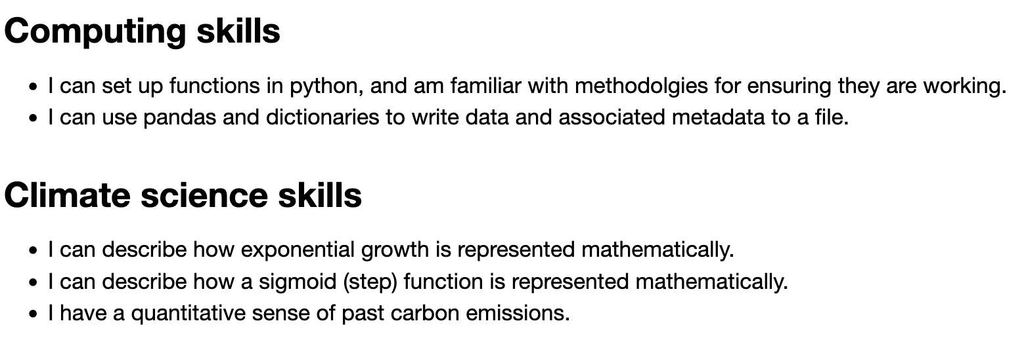
Week 5 – Adaptive flows and scheduled flows

Slide 15
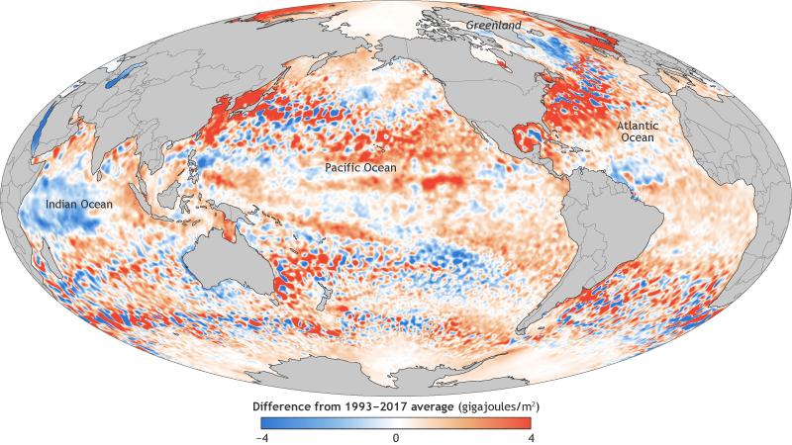
Weeks 3-4 – EzGCM
Learning goals
What ”climate variables” are
A sense of the uneven-ness of the impacts of climate change
Differences between ICCP’s Representative Concentration Pathways (RCPs)
What anomaly maps are

Slide 16
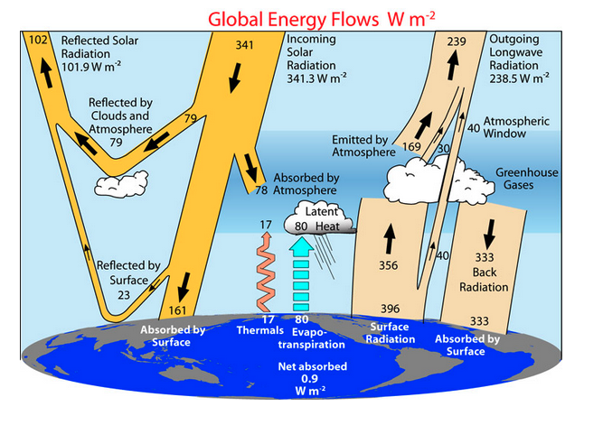
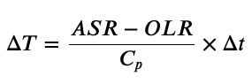
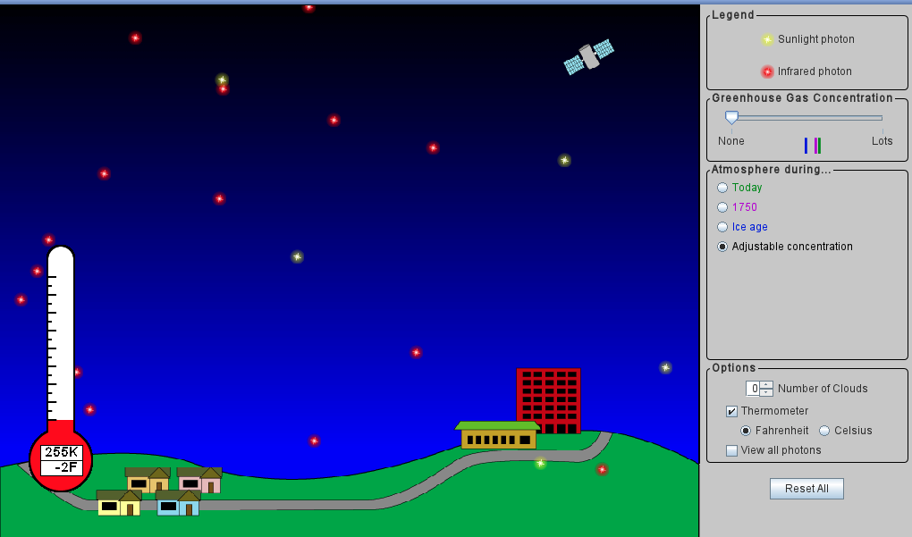
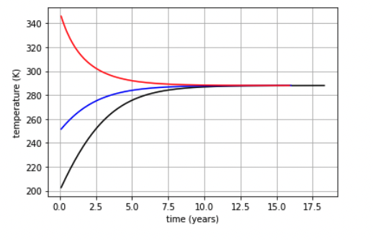
Week 2 – Radiative balance
If ASR > OLR, Earth will heat up
If ASR < OLR, Earth will cool down
Homeostasis

Slide 17
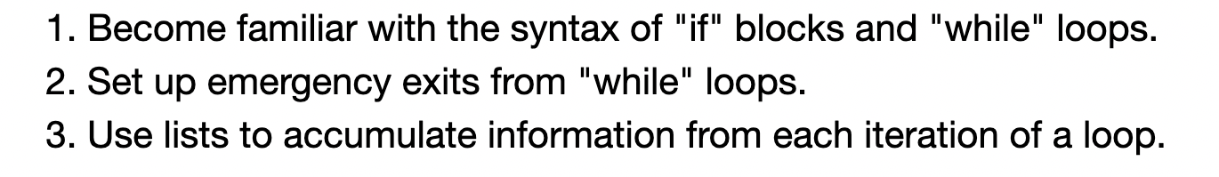
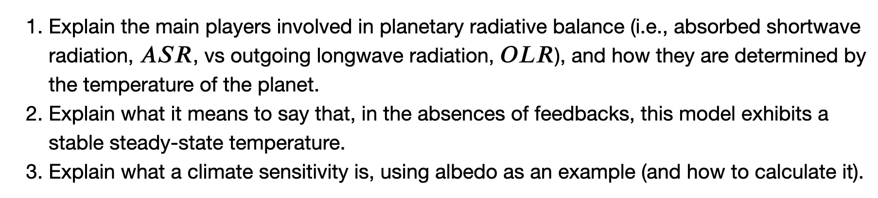
Week 2 – Radiative balance
Week 2a
IfAndWhile
Week 2b
SimpleRadiativeBalance

Slide 18
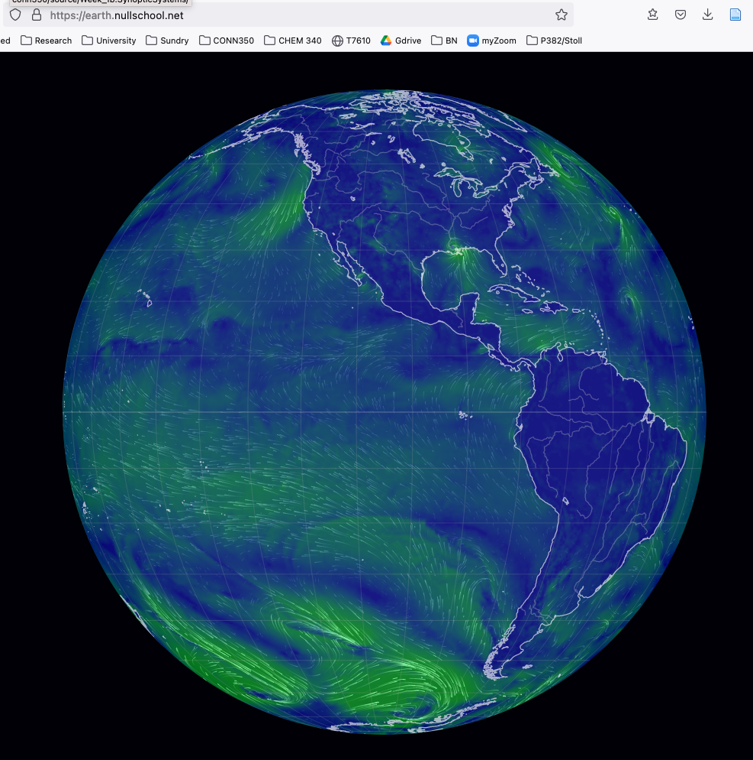
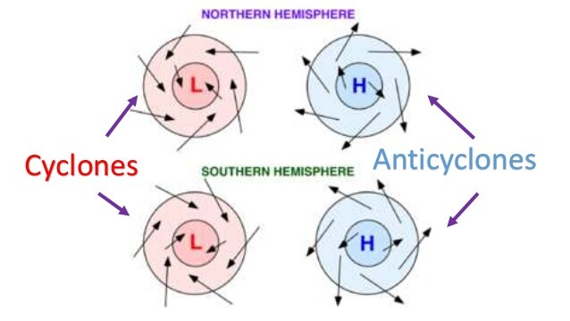
Week 1 – From weather to climate
https://revision.co.zw/cyclones/
earth.nullschool.net

Slide 19
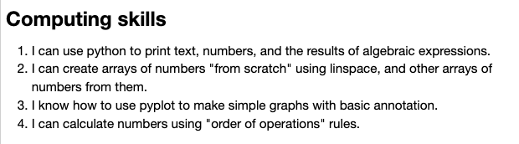
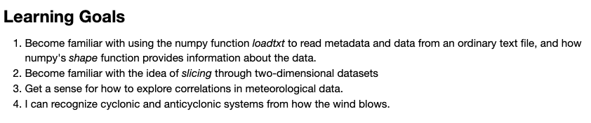
Week 1 – From weather to climate
Week 1a
Arrays
Week 1b
Synoptic Systems

